Slide 1
CHARACTERIZING DIABETES, DIET, OBESITY & EXERCISE COMMENTS ON TWITTER
222IT018-Pankaj Kumar Magar
222IT034-Vedant Parwal
Title of base paper: Characterizing diabetes, diet, obesity & exercise comments on twitter
Link: https://www.sciencedirect.com/science/article/abs/pii/S0268401217306126

Slide 2
Introduction
Analyze the characteristics of the general public's opinions regarding diabetes, diet, exercise and obesity (DDEO) as expressed on Twitter to find correlations among the DDEO topics.
According to WHO, The global prevalence of obesity has tripled between 1975 and 2016, with more than 1.9 billion adults considered as overweight and over 650 million adults considered as obese.
Overweight and obesity are the fifth leading risk for global deaths according to the European Association for the study of Obesity.
Studies show that there are strong relations among diabetes, diet, exercise, and obesity (DDEO).

Slide 3
Literature Review (only one slide)
Author/year | Methodology | Advantages | Limitations
Liangjie Hong and Brian D. Davison / 2010 | Two models LDA and Author Topic Model is used. | Topic models can be used for short text scenarios(microblogging environment). | Dataset contains 52,606 distinct terms and 50,447 messages in total. It is good for short text scenarios.
Corey Arnold and William Speier / 2012 | Presented a model that links topics to time within a corpus by observing a time stamp for each document. | Proposed model was able to learn temporal trends between topics in patient records. | In a general context these medical stop words may prove useful, but limited to the domain of clinical reporting they offer little semantic meaning.
Biraj Dahal , Sathish A.P. Kumar , Zhenlong LI / 2019 | The goal of this study is to perform volume analysis, sentiment analysis, and topic modeling to a collection of tweets and compare these results over space and time. | Highlights on topic modelling along with sentiment analysis and volume analysis. | Major limitation of this study is that many tweets in the dataset are indecipherable, making both topic modeling and sentiment analysis ineffective on those tweets

Slide 4
Outcome of Literature Review (only one slide)
Literature review of the above papers gave the idea on how to perform LDA on short text with reference to paper [1] .
Also to get the temporal trends between the topics with reference to paper [2].
Overview of sentiment analysis along with topic modelling with reference to paper[3].

Slide 5
Problem Statement
Understanding public health opinions on social media to characterise common health issues such as Diabetes, Diet, Exercise and Obesity(DDEO).
Research Objectives
Analyse the characteristics of the general public’s opinions regarding diabetes, diet, exercise and obesity (DDEO) as expressed on Twitter.
Find notable correlation among the DDEO topics.

Slide 6
Existing Methodology
Latent Dirichlet Allocation
LDA
Data Collection
Data Cleaning
Find Optimal Topics
Correlation
LSA
Latent Semantic Analysis

Slide 7
Existing Methodology(2)
Data Collection: Collect user’s opinions on twitter using Twitter API.
Data Cleaning: Pre-process the data obtained.
Topic Discovery: Apply Topic Modelling techniques to discover the topics.
Topic Content Analysis: Making observations about how topics are related.

Slide 8
Topic Discovery
Topic Discovery or modelling is a type of statistical model for discovering the abstract "topics" that occur in a collection of documents.
Topic modelling is a method for unsupervised classification of documents, similar to clustering on numeric data, which finds some natural groups of items or topics.
Topic Modelling can help with:
Discovering the hidden themes or topics in a document or corpus.
Classifying the document into discovered themes or topics.
Here we are using two types of topic modelling namely Latent Semantic Analysis (LSA), Latent Dirichlet Allocation (LDA)

Slide 9
Steps for Topic Discovery
Each document is just a collection of words or a “bag of words”. Thus, the order of the words and the grammatical role of the words are not considered in the model.
Number of topics k is pre-decided.
We can sort the words with respect to their probability score. The top x words are chosen from each topic to represent the topic. If x = 10, we’ll sort all the words in topic1 based on their score and take the top 10 words to represent the topic.

Slide 10
Latent Dirichlet Allocation
Latent Dirichlet Allocation(LDA) uses Dirichlet priors for the document-topic and word-topic distributions, lending itself to better generalization.
Aim of LDA is to find topics a document belongs to, based on the words in it.
LDA considers corpus is made up of multiple topics, those topics which then generate words based on the probability distribution.
LDA is an effective computational linguistics model for discovering topics in a corpus.
Used the mallet implementation of LDA.

Slide 11
Latent Dirichlet Allocation (2)
Steps for LDA:
The processed data is lemmatized keeping only noun, adjective, verb using spacy.
Using this lemmatized tokens, we form a dictionary and document term matrix.
This dictionary and document term matrix is inserted into the mallet LDA model.
Initially, no. of topics provided to the model is 20 which gives us a coherence score of 0.3475.
Optimal no. of topics for the LDA is 222 with coherence score of 0.7674.

Slide 12
Proposed enhancements/novelty
LSA, which is also used for Topic Modelling is a technique in NLP, especially in distributional semantics. It analyses the relationship between a set of documents and the terms these documents contain.
LSA (Latent Semantic Analysis) uses bag of word(BoW) model, which results in a term-document matrix(occurrence of terms in a document). Rows represent terms and columns represent documents.
LSA learns latent topics by performing a matrix decomposition on the document-term matrix using Singular value decomposition. LSA is typically used as a dimension reduction or noise reducing technique.

Slide 13
Proposed enhancements/novelty
The main challenge is that the matrix is very sparse (or high dimension) and noisy (or include lots of low frequency word). So truncated SVD is adopted to reduce dimension.
The idea of SVD is finding the most valuable information and using lower dimension t to represent same thing.
This dictionary and document term matrix is inserted into the LSA model.
Initially, no. of topics provided to the model is 20 which gives us a coherence score of 0.3495.
Optimal no. of topics for the LSA is 222 with coherence score of 0.4132.

Slide 14
Dataset statistics
Used Twitter API for scraping of tweets
Obtain a total of 92,000 tweets for the pilot task, with each category contains 23000 tweets.
Tweets related to Diabetes, Diet, Obesity and Exercise have been scraped based on these four queries:
Diabetes: diabetes OR #diabetes
Diet: diet OR #diet OR dieting
Exercise: exercise OR #exercise OR exercising
Obesity: obesity OR #obesity OR fat

Slide 15
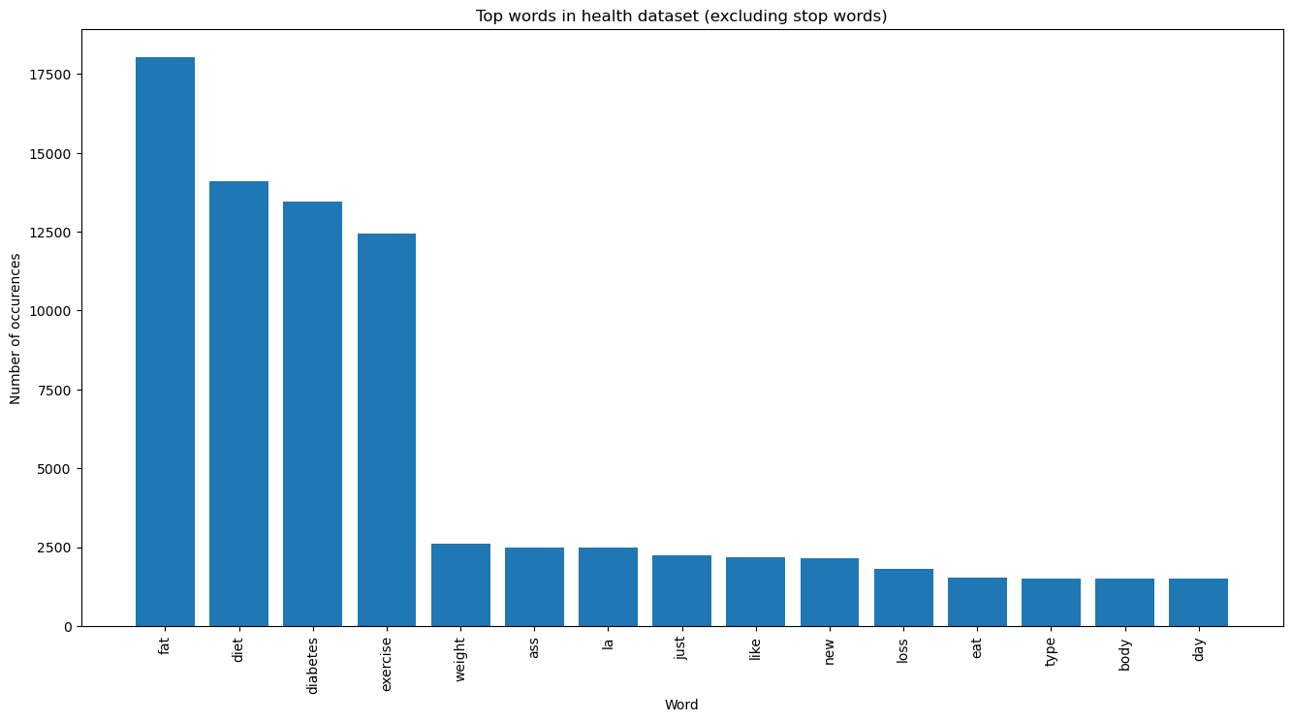
Dataset Analysis

Slide 16
Data Pre-Processing
Add details of studies done as part of lab assignments and report insights into the dataset.
For pre-processing the tweets, the following steps are performed:
Removing irrelevant characters and links
Converting all the characters to lowercase
Removing contractions
Removing punctuations
Removing extra whitespaces
Removing empty tweets
Removing non-English words
Removing stop words

Slide 17
Work done
Dataset collection – 92000 tweets scrapped using Twitter API by using twitter id’s
Data Pre-processing – Removed stop words , whitespaces , empty tweets etc.
LDA Topic Modelling – Topic modeling technique for discovering topics in a corpus.
LSA Topic Modelling – Another topic modeling technique used for dimensionality reduction.
Finding the correlation – Gives the outcome how two terms in DDEO are related.

Slide 18
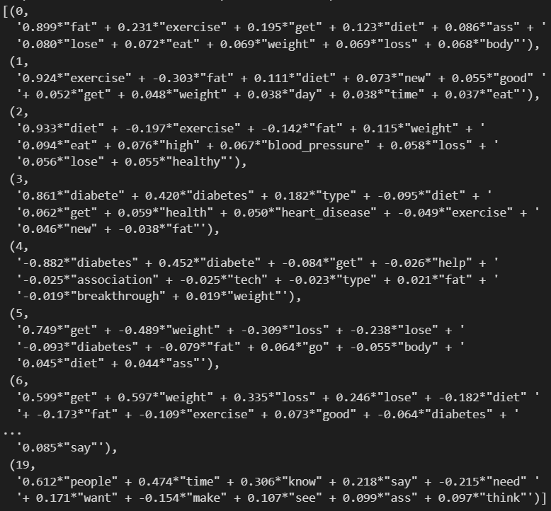
Experiments and Results
Snippet of topics from the topic modelling: The optimal topics obtained from the Topic modelling techniques which can also be used to calculate the correlation between the topics.

Slide 19
Experiments and Results (2)
Coherence Score: Topic Coherence measures score a single topic by measuring the degree of semantic similarity between high scoring words in the topic. These measurements help distinguish between topics that are semantically interpretable topics and topics that are artifacts of statistical inference.
Modelling Technique | Optimal no of topics | Coherence score
LDA | 222 | 0.5473
LSA | 222 | 0.4132
LSA TF-IDF | 222 | 0.457
LDA TF-IDF | 222 | 0.5224

Slide 20
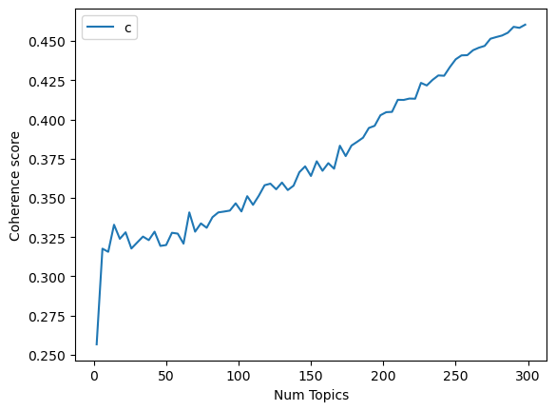
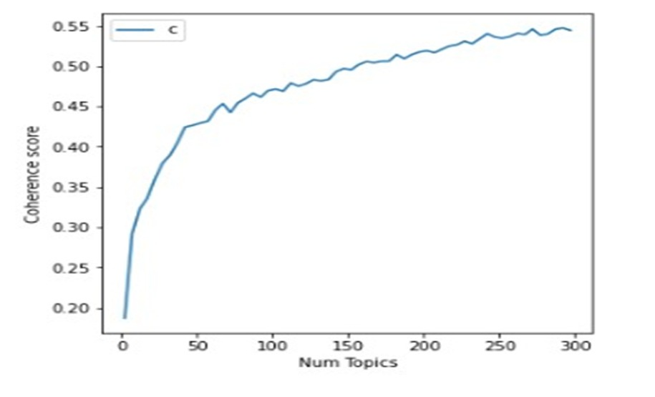
Experiments and Results (3)
Coherence score Vs Number of topics in LDA
Coherence score Vs Number of topics in LSA

Slide 21
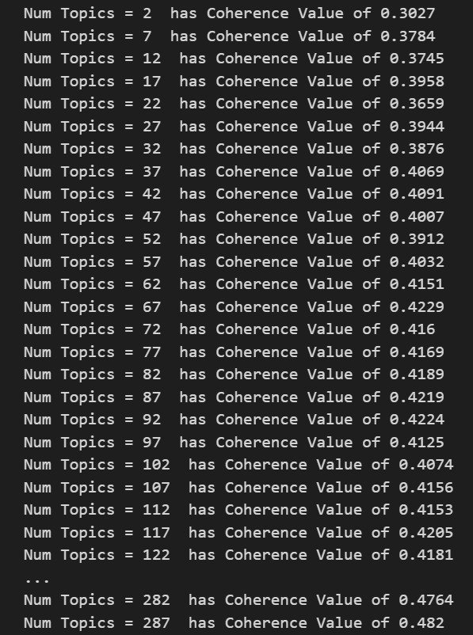
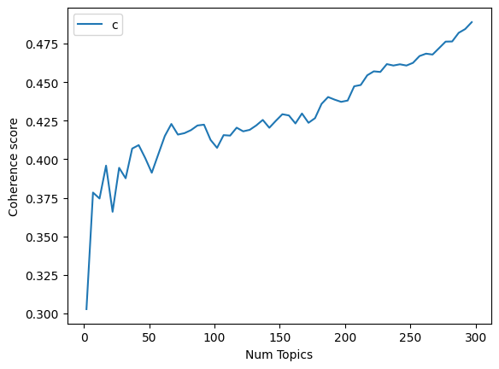
LSA_TF-IDF
Coherence Score : 0.457

Slide 22
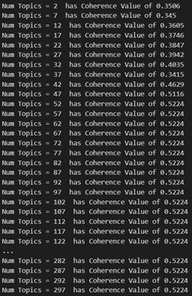
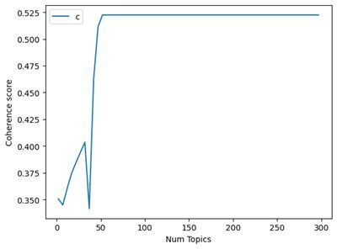
LDA_TF-IDF
Coherence Score : 0.5224

Slide 23
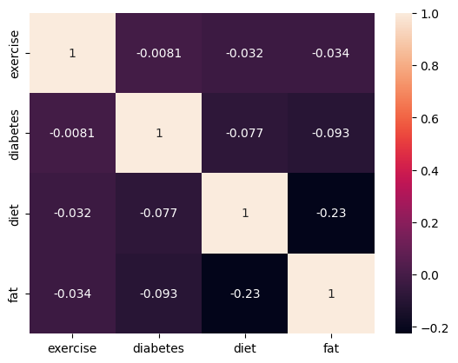
Experiments and Results (6)
Correlation plot between the topics:
The strongest correlation was found between topics Diet and Obesity (-0.23) and lowest correlation between Diabetes and Exercise(-0.0081).

Slide 24
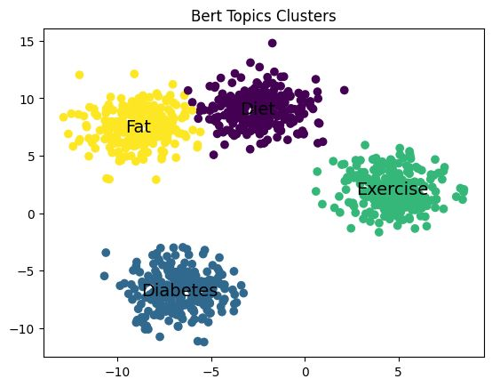
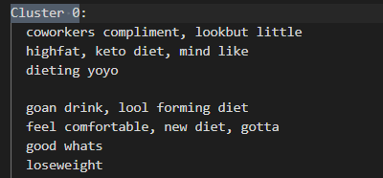
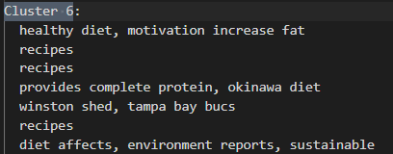
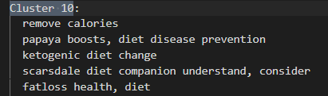
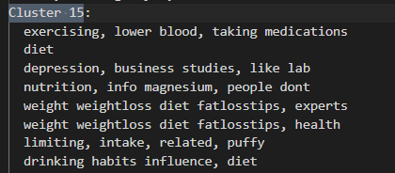
Bert Embedding
Bert Embedding Topics

Slide 25
Comparative Results (w.r.t Base paper)
 | Base Paper | Our Results
No. of Tweets | 4.5 million | 0.092 million
Dataset balanced | No | Yes
Strongest Correlation | Exercise and Obesity | Diet and Obesity
Weakest Correlation | Exercise and Diabetes | Exercise and Diabetes

Slide 26
Conclusion and Future work
LDA gave a better coherence score for the same number of optimal topics then LDA-TF-IDF, LSA and LSA-TF-IDF because LSA was mostly concentrated on the dimensionality reduction and LDA-TF-IDF only considers frequency of words within documents.
The bert embedding model generates topics that are much more interpretable and can visualized in better way.
The diabetes had the most common sub-topic as type 2 diabetes and other non-health related topics such as yoga.
Similarly for diet, the most common sub-topic was fat and weight loss.

Slide 27
Conclusion and Future work(2)
The correlation between these topics show the strongest correlation between the topics diet and obesity. The lowest correlation was found between topics diabetes and exercise.
The work can be extended by considering larger dataset and using other health related techniques for better understanding of public opinions on social media.

Slide 28
Individual Contribution
Dataset collection – Pankaj, Vedant
Pre-processing – Pankaj, Vedant
LDA Topic Modelling - Vedant
LSA Topic Modelling - Pankaj
Topic analysis and finding the correlation- Pankaj, Vedant

Slide 29
References
Hong, L., & Davison, B. D. (2010). Empirical study of topic modeling in Twitter. Proceedings of the first workshop on social media analytics. ACM80–88.
Arnold, C., & Speier, W. (2012). A topic model of clinical reports. Proceedings of the 35th international ACM SIGIR conference on research and development in information retrieval. ACM1031–1032.
Dahal, B., Kumar, S. A., & Li, Z. (2019). Topic modeling and sentiment analysis of global climate change tweets. Social network analysis and mining, 9, 1-20.

